Slide 1
3D Dynamic Scene Understanding based on NeRF
Previous studies – from semantic/static to instance/dynamic
Existing challenges

Slide 2
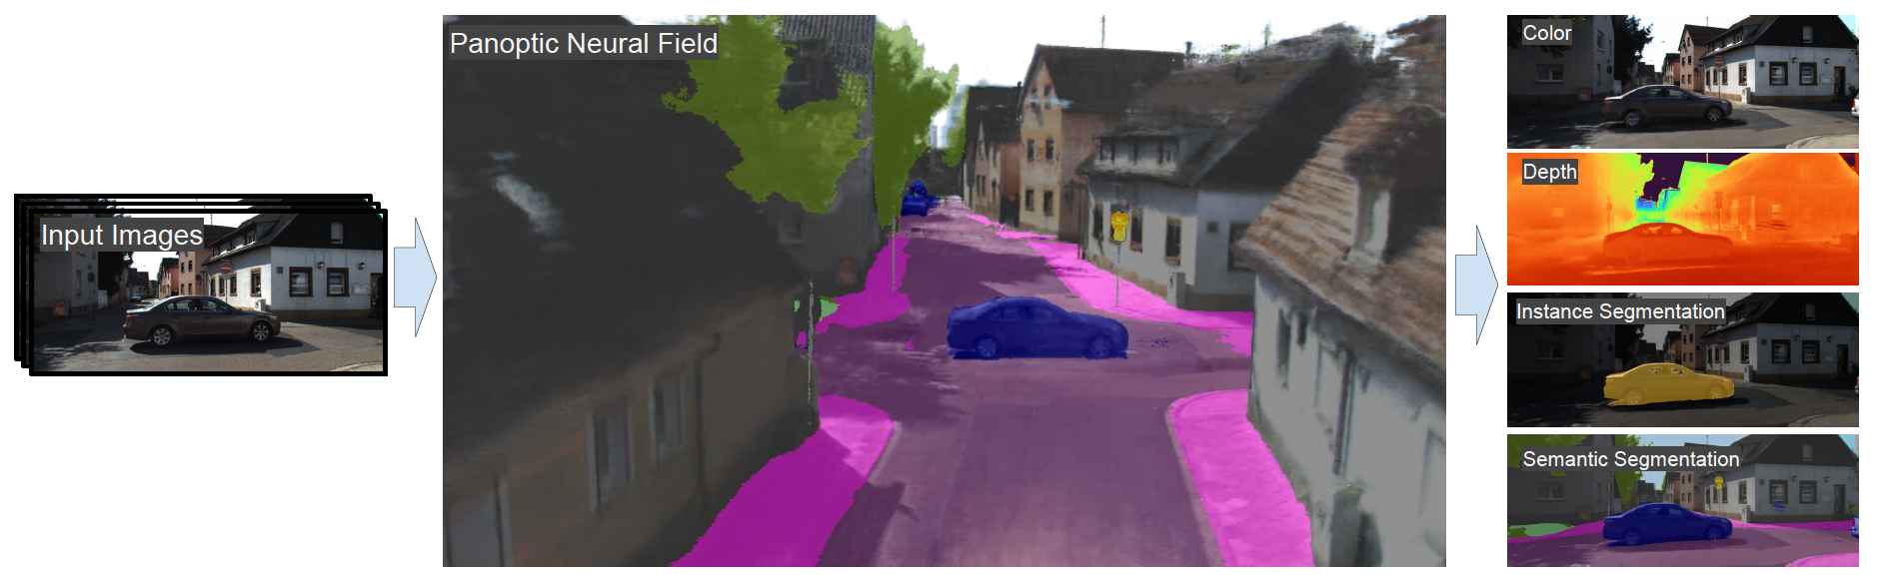
Previous studies
Semantic Object-Aware Neural Scene Representation (most recent)
Use neural rendering method that decomposes dynamic scenes into scene graphs.
One MLP for each thing (instance)

Slide 3
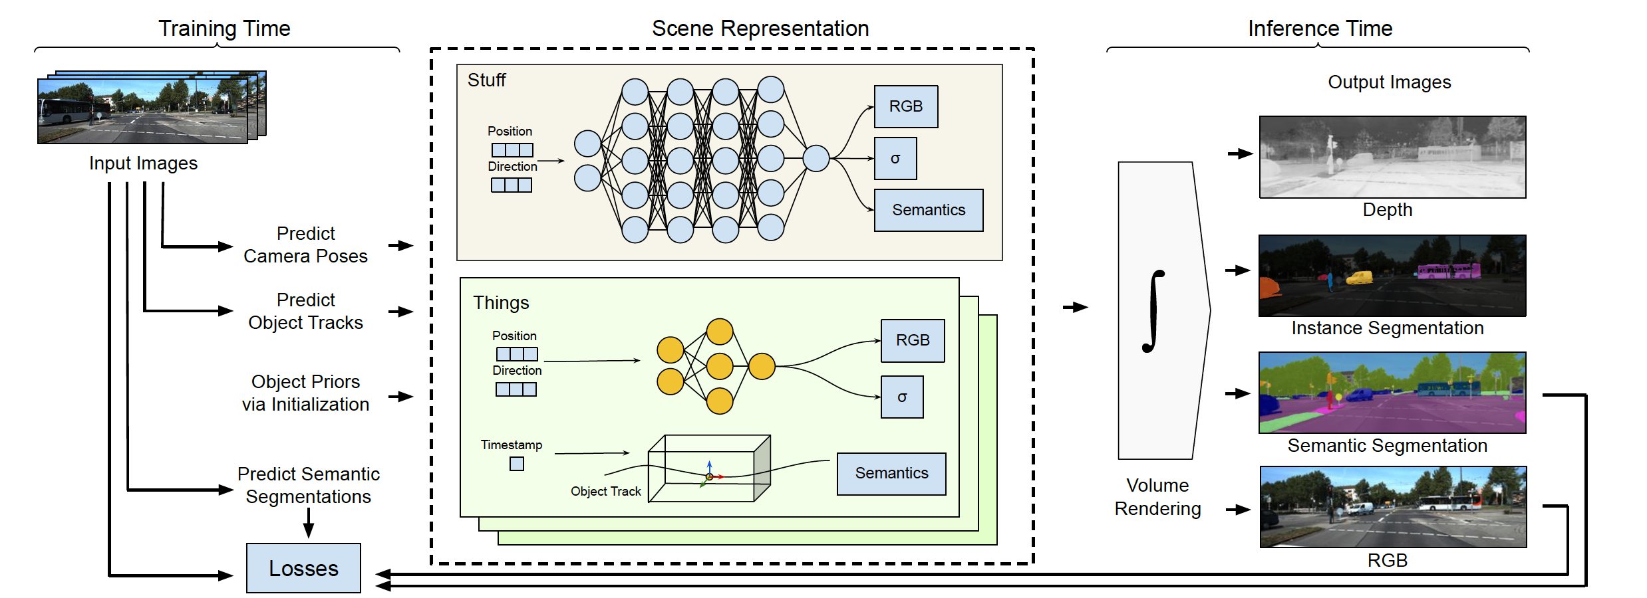
Previous studies

Slide 4
Previous studies – 3D dynamic scene understanding
+ instance modeling
Dynamic
Instance-level
Object-NeRF
Neural SG for Dynamic
Panoptic NeRF
DM-NeRF
Object-NeRF
Semantic
Semantic NeRF
(2021)
Instance and Dynamic
PNF (outdoor)
Panoptic Lifting (indoor)
Feature-level
Neural Feature Fusion Fields
+ visual feature distillation

Slide 5
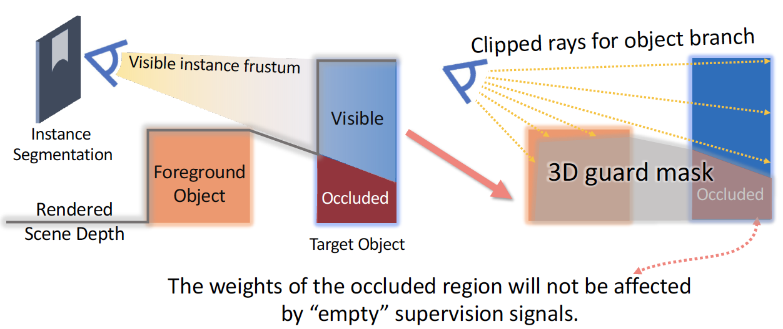
Existing challenges
Correspondences between images are built via SLAM, which is time-consuming and not robust to complex lighting conditions.
Occlusion parts of the scene.

Slide 6
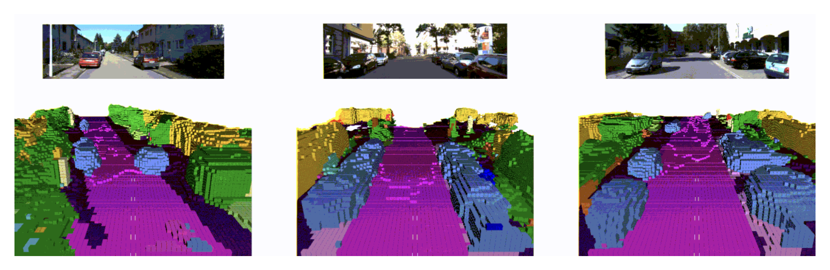
Existing challenges
Completion/prediction/rendering of occluded parts.
Speed up or enhance rendering with point clouds.

